Slide 1
LECTURE 8 outline
Stop and wait ARQ
GO Back N ARQ
Selective Repeat ARQ

Slide 2
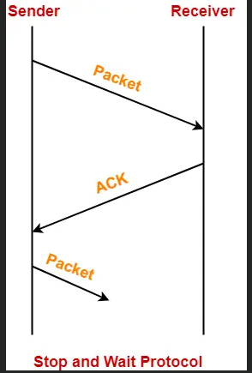
Stop and Wait Protocol-
In stop and wait protocol,
Sender sends one data packet and then waits for its acknowledgement.
Sender sends the next packet only after it receives the acknowledgement for the previous packet.

Slide 3
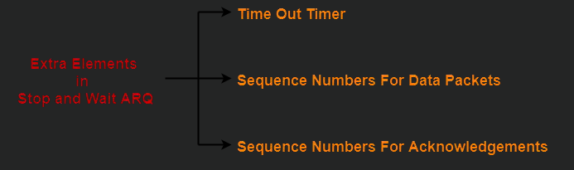
The main problem faced by the Stop and Wait protocol is the occurrence of deadlock due to-
Loss of data packet
Loss of acknowledgement
Stop and Wait ARQ is an improved and modified version of Stop and Wait protocol.
Stop and wait ARQ includes the following three extra elements.
Stop and wait ARQ is a one bit sliding window protocol where-
Sender window size = 1
Receiver window size = 1

Slide 4
Thus, in stop and wait ARQ,
Minimum number of sequence numbers required
= Sender Window Size + Receiver Window Size
= 1 + 1 = 2

Slide 5
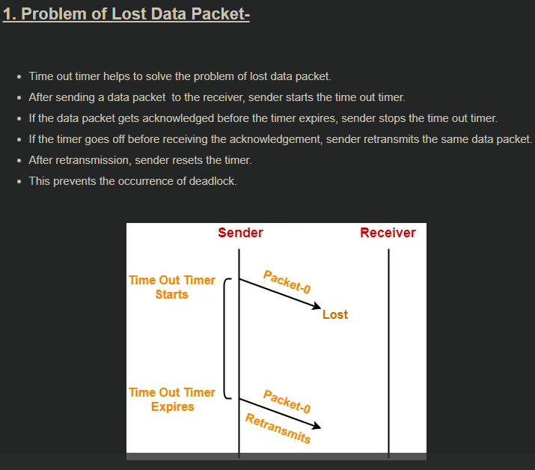

Slide 6
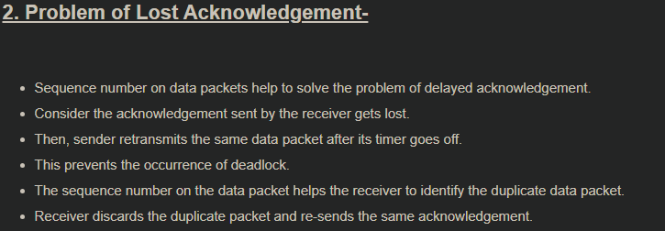
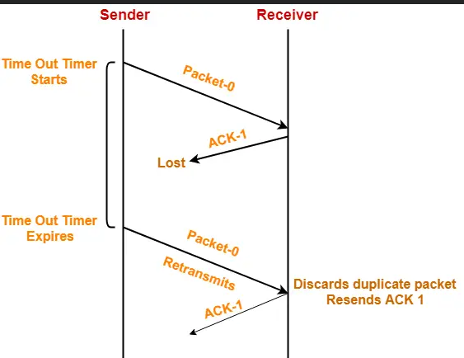

Slide 7
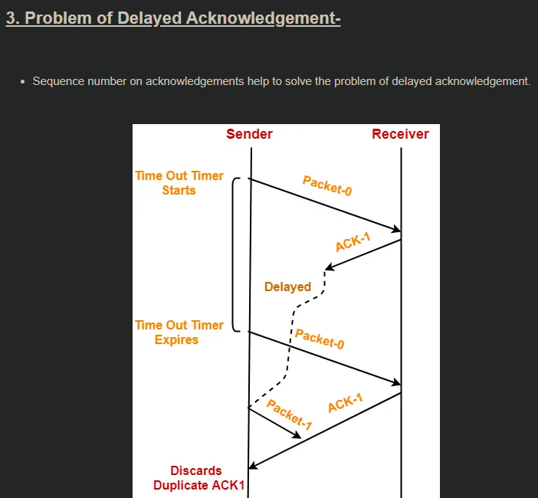

Slide 8
Go back N Protocol-
Go back N protocol is an implementation of a sliding window protocol.
The features and working of this protocol are explained in the following points-
In Go back N, sender window size is N and receiver window size is always 1.
Sender window size = N. Example in Go back 10, sender window size will be 10. Receiver window size is always 1 for any value of N.
Go back N uses cumulative acknowledgements.
Go back N may use independent acknowledgements too.
Go back N does not accept out of order frames and silently discards them.

Slide 9
Working of GB-N Protocol
Now what exactly happens in GBN, we will explain with a help of example. Consider the diagram given below. We have sender window size of 4. Assume that we have lots of sequence numbers just for the sake of explanation. Now the sender has sent the packets 0, 1, 2 and 3. After acknowledging the packets 0 and 1, receiver is now expecting packet 2 and sender window has also slided to further transmit the packets 4 and 5. Now suppose the packet 2 is lost in the network, Receiver will discard all the packets which sender has transmitted after packet 2 as it is expecting sequence number of 2
On the sender side for every packet send there is a time out timer which will expire for packet number 2. Now from the last transmitted packet 5 sender will go back to the packet number 2 in the current window and transmit all the packets till packet number 5. That’s why it is called Go Back N. Go back means sender has to go back N places from the last transmitted packet in the unacknowledged window and not from the point where the packet is lost.

Slide 10
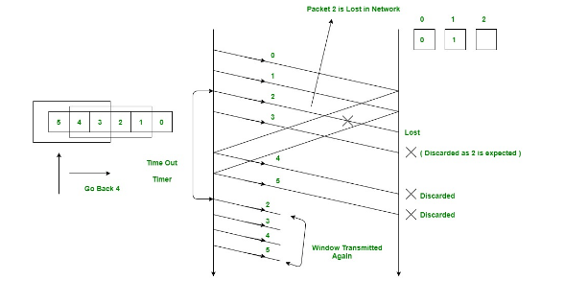

Slide 12
Selective Repeat Protocol-
Selective Repeat protocol or SR protocol is an implementation of a sliding window protocol.
The features and working of this protocol are explained in the following points-
In SR protocol, sender window size is always same as receiver window size.
SR protocol uses independent acknowledgements only.
SR protocol does not accept the corrupted frames but does not silently discard them.
SR protocol accepts the out of order frames.
SR protocol requires sorting at the receiver’s side.
SR protocol leads to retransmission of lost frames after expiry of time out timer.

Slide 14
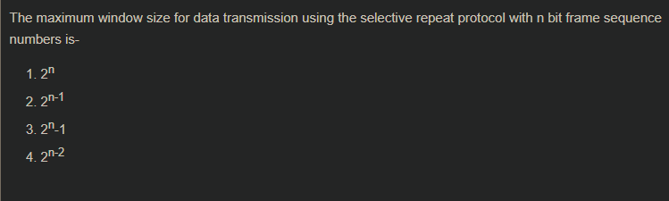

Slide 15
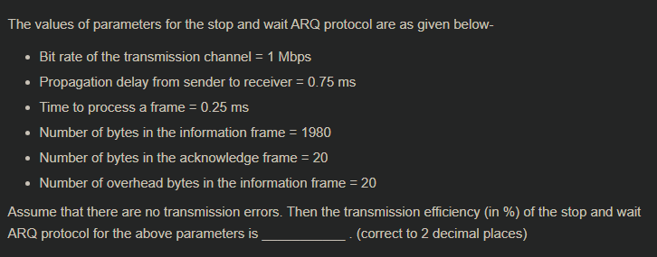

Slide 16
